Slide 1
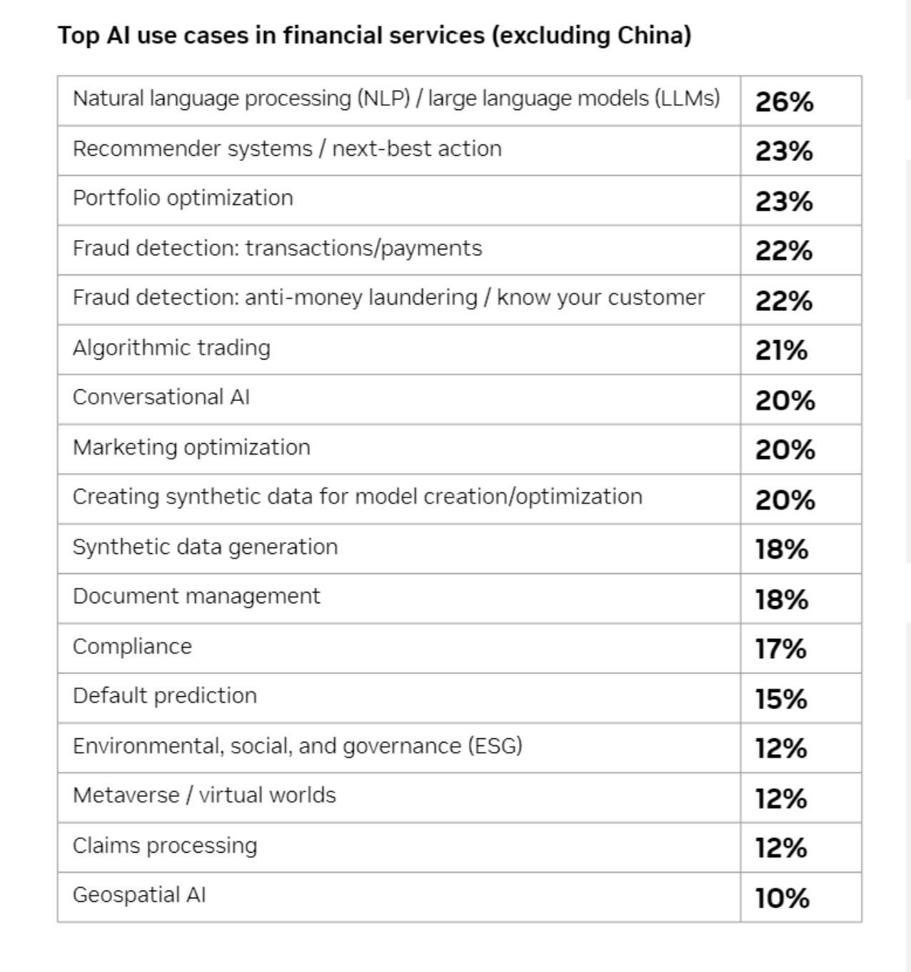
Content heavy banking functions will undergo radical shift, with a potential to bring in unprecedented innovation in products and services
Already a lead industry in AI adoption, Banking will witness never seen use cases before, that are powered by Large Language Models/GenAI
-Content development and communication becomes more versatile and easy, particularly in marketing, customer interactions and collection.
-Banking risk, compliance and regulatory work, particularly around KYC, AML, Regulatory Scanning & Reporting is all made more efficient. It is likely transform the way Risk, Fraud and Compliance departments operate
-Relationship Management in Commercial Banking and Wealth & Asset Management becomes more dynamic and a lot more contextual
-Brining business closer to IT as low code/no code value proposition gets fully developed and businesses can do their own level1 technology work
-Allowing new product development and innovation as hard coded legacy systems get decoupled with new way of programming and coding.
nVIDIA 2023 State of AI In Financial Services

